Slide 1
KNAPSACK & Nash cryptosystems
CHRISTINA JACOB
SREEKALA S.

Slide 2
CONTENTS
Introduction
Knapsack Cryptosystem
Knapsack Problem
Cryptosystem
Analysis
Nash Cryptosystem
Idea suggested by John NSA
Cryptosystem
Analysis
Conclusion

Slide 3
Introduction
Symmetric key cryptography
Nash cryptosystem
Asymmetric key cryptography
Knapsack cryptosystem

Slide 4
Knapsack problem
Classical combinatorial problem
Subset Sum Problem
Given a set of numbers A and a number S, find a subset of A, which sums to S
Class NP-Complete
If set A is superincreasing, problem reduces to class P.

Slide 5
description
X – Set of binary numbers
A – Set of numbers
S = x₁a₁ + x₂a₂ + …. + x_{k}a_{k}
We can develop a cryptosystem where
X – Plaintext
S – Ciphertext
A – Key
Given S and A it is not possible to find X

Slide 6
Implementation
KEY GENERATION
Create a superincreasing k-tuple b= [b1,b2,…,bk]
Choose a modulus n, such that n > b1+b2+…bk
Select a random integer r that is relatively prime with n and 1<=r<=n-1
Create a temporary k-tuple t=[t1,t2,…,tk] in which ti = r bi mod n
Select a permutation of k objects and find a new tuple a = permute(t)
Public Key : a
Private Key : n, r and b

Slide 7
ENCRYPTION
Plaintext is k-tuple X = [X1,X2,…,Xk]
Calculate S = X₁a₁ + X₂a₂ + …. + X_{k}a_{k}
Sends the value of S as the ciphertext
DECRYPTION
Calculate S’ = r⁻¹ S mod n
Calculate X’ from S’
Permute X’ to X to get plaintext

Slide 8
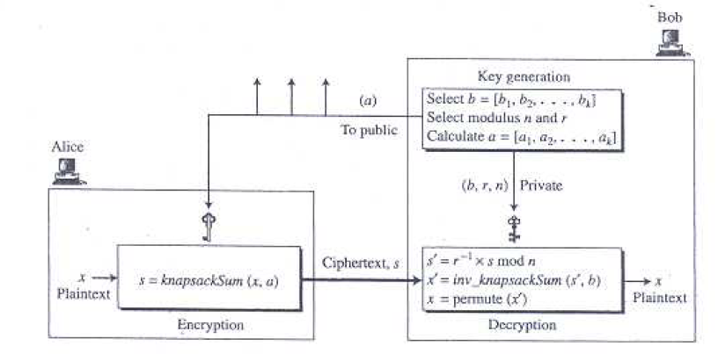
Cryptosystem

Slide 9
ANALYSIS
Main advantage – Speed – 100 times faster than RSA
Set A is not purely random – Its contains hidden information about the superincreasing sequence.
Shamir has shown that it is possible to recover the initial message m, even if the private key remains unknown.
Low Density Problem
Density d = k/max log₂(a_{i})
If d <= 0.9408 , knapsack problem can be reduced to closest vector problem (CVP)
CVP can be solved using polynomial time approximation algorithm

Slide 10
Nash cryptosystem

Slide 11
Nash letters to nsa
John Nash
His letters to NSA
declassified recently
wrote in 1955
Introduction to complexity theory
Rejected due to lack of security and his mental conditions

Slide 12
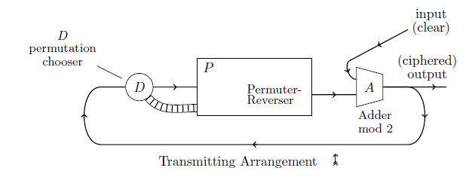
ENCRYPTION
Adder
Plaintext + output of Permuter -> Ciphertext
Supplies feedback
Decider – decides the permutation path
Permuter – performs encryption

Slide 13
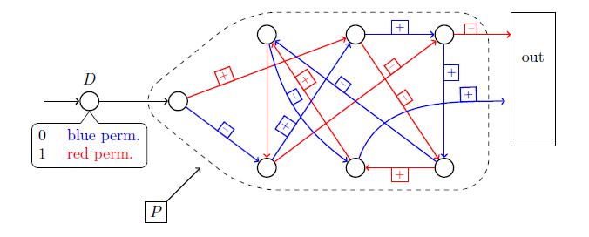
permuter
Permuter contains an already established number of digits remembered within it.
Two permutation paths – path is determined by bit in the Decider
During each cycle
Permuter shuffles around the numbers inside it.
sends one digit on and takes another one in from D.
2
3
4
1
5
6
7

Slide 14
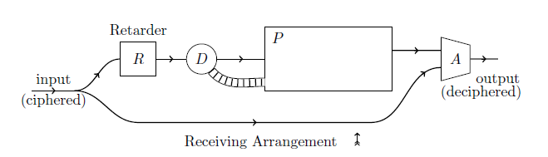
decryption
P1 = C1 xor const
P2 = C2 xor Pr(C1)
Pi = Ci xor Pr(Ci-1)

Slide 15
analysis
Reluctance to accept innovation - Computational hardness
Permuter is similar to rotor machine which can be broken
Linear feedback shift register is a weak key generator

Slide 16
conclusion
The problem is NP-hard isn’t enough to make it a good key generator.
Knapsack cryptosystem - based on an NP-hard problem.
NP-hard only in the worst case.
Average case is only P-hard.
We still don’t have cryptosystems which are provably NP-hard for all cases.
Factoring and elliptic curves are as good as it gets, and there’s still the possibility that a breakthrough could make factoring easy.

Slide 17
THANK YOU

